Slide 1

Drone Obstacle Avoidance Using PyTorch Lightning and the Tello EDU

Slide 2
Roadmap
Overview of the Training CNN Model Architecture
Train our CNN Model for Obstacle Avoidance
Autonomously fly a Tello Drone using our newly trained model

Slide 3
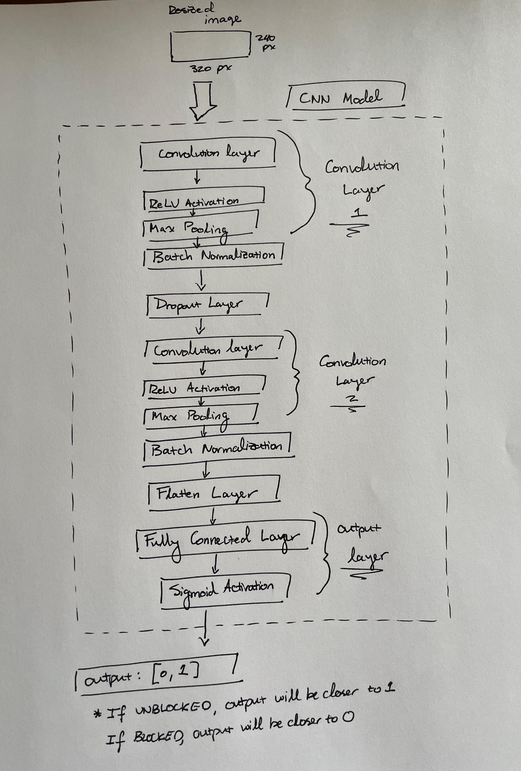
Training CNN Model Architecture
Highlights of the architecture include:
Convolutional Layers: Extract features and reduce spatial dimensions of the input data
Batch Normalization Layers: Normalize the input data during training, helping to stabilize learning across layers
Dropout Layer: introduce random and temporary dropout of neurons during training. This helps to (1) prevent overfitting and (2) forces the network to learn more robust features
Sigmoid Activation Output Layer: Output from the model is limited between [0, 1] – depicting the probability of an input image being UNBLOCKED (output closer to 1) or BLOCKED

Slide 4
Train Our CNN Model for Obstacle Avoidance: Training Methodology
Choosing the right loss function: Binary Cross Entropy (BCE) Loss
BCE is commonly used for binary classification and measures the dissimilarity between predicted probabilities (output from our model) and the true labels
Choosing an appropriate optimizer: Adam
The Adam optimizer is a popular optimizer choice in the ML community due to its (1) adaptive learning rate, (2) efficient memory usage, and (3) reliably effective optimization performance
Avoid overfitting by utilizing Early Stopping
The goal of early stopping is to find the point at which the model’s performance on a validation set starts deteriorating. Once this is noticed, we stop training
For our purposes, the metric by which we will evaluate validation performance deterioration will be from monitoring Validation Loss. Once validation loss is not improved for 3 epochs, we will stop training.

Slide 5
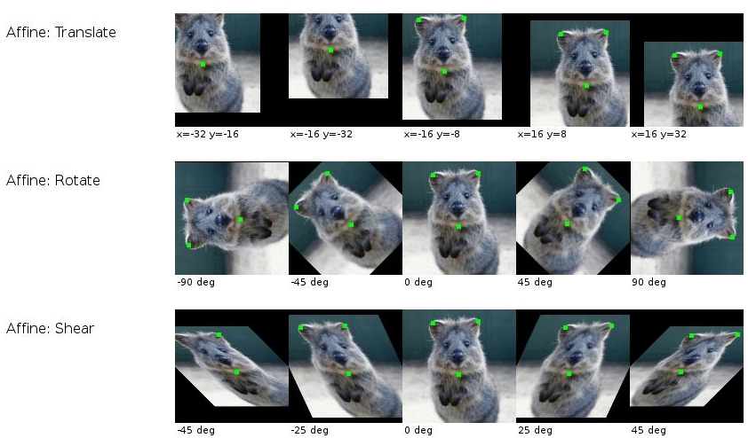
Train Our CNN Model for Obstacle Avoidance: Data Preconditioning
Prior to beginning training, we transform our training dataset in two different ways:
(1) Resize our images to be smaller: Large images require a significant amount of memory to store and process – resizing images reduces the memory and computational footprint.
Specifically, we are resizing our images from 960x720 to 320x240
(2) Data Augmentations: Augmentation techniques increase the diversity of our training samples, helping the model to generalize and be more robust to variations in the test data
Specifically, we are augmenting our images by performing:
Random Rotation: A random amount of images are rotated by +/- 15 degrees
Random Horizontal Flip: A random amount of images are flipped horizontally
Random Affine Shift: A random amount of images are sheared by +/- 15 degrees

Slide 6
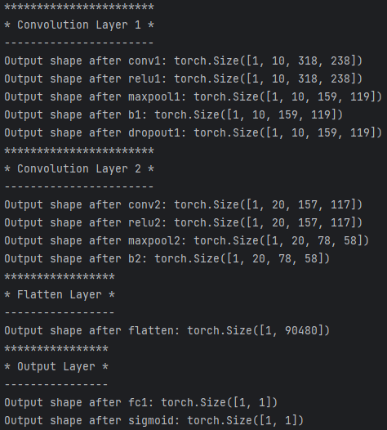
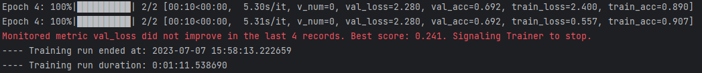
Train Our CNN Model for Obstacle Avoidance: Using the Script
On your desktop, ensure that your “sorted_data” directory has been transferred over
Open the “Tello-Flight-Inference” directory in PyCharm, double-click on “3_train.py” to open the file in the Editor Window, and click the Green Play Button to start training your model from your dataset
Note that training is done using a PyTorch Lightning framework (so hopefully you remember the presentation from a few days ago!)
Training should take a few minutes per run, and will be accompanied by a plethora of printout information from the “Run” Terminal
Printout information during training includes:
Output shape after each layer in our model
Training/Validation Accuracy for each epoch
Debug information surrounding our early stopping monitor for Validation Loss

Slide 7
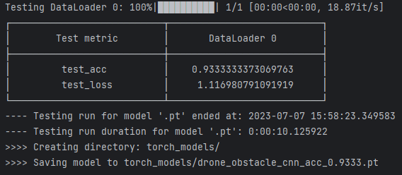
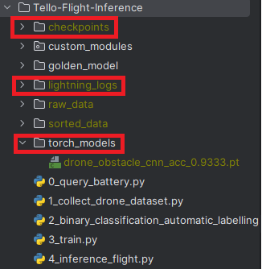
Train Our CNN Model for Obstacle Avoidance: Using the Script (cont.)
Once training has completed, a summary depicting the Training Accuracy and Training Loss should be printed to your “Run” Terminal
You should also notice that a few new directories have been created:
checkpoints: “checkpoint” files are stored during training, but we will not be using these during the workshop
lightning_logs: PyTorch Lightning inherently includes a plethora of additional debug information during training. These files are outside the scope of this workshop, but it is useful to know that these files exist!
torch_models: This directory stores our newly trained models, where the filenames depict the training accuracy achieved for that particular model
For instance, our model achieved a test accuracy of 93.33%, so the saved filename is “drone_obstacle_cnn_acc_0.93333.pt”
Once you have trained a few times, transfer the torch_models directory to your laptop under the Tello-Flight-Inference directory

Slide 8
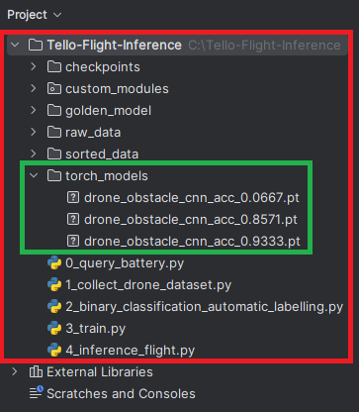
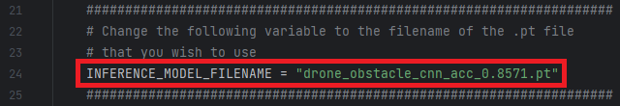
Taking Autonomous Flight
Back on your laptop, ensure that your Tello-Flight-Inference directory has the torch_model directory stored similar to the top image
Once verifying a similar directory structure, double click on “4_inference_flight.py” to open the file in the Editor window, you will have to change one line of code (around line 24) to reflect the filename of the model that you wish to run inference through

Slide 9
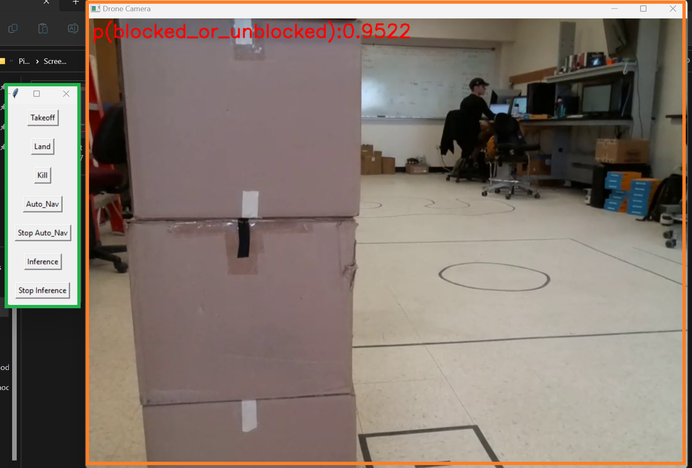
Taking Autonomous Flight (cont.)
Once you have made the filename change to your file, press the Green Play Button in the upper right-hand corner in PyCharm
The script should launch two separate windows:
Command Button Window: Popup window designated for the different available commands (details on next few slides)
Drone Camera Window: Popup window showing a live video feed from the Drone as well as giving the probability of being UNBLOCKED (closer to 1) or BLOCKED (closer to 0) in the upper left-hand corner

Slide 10
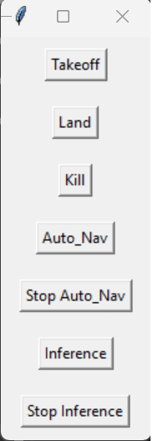
Command Button Window Rundown
Takeoff: If the drone is currently on the ground, it will takeoff to a steady height (roughly waist-level)
Land: If the drone is currently on the ground, immediately land
Kill: Immediately kill all operations and tell the drone to land
Auto_Nav: Begin autonomous flight (by using the inference model that you want loaded in)
Stop Auto_Nav: Stop autonomous flight and have the drone hover in place
Inference / Stop Inference: These commands were included for debug purposes, so you don’t need to worry about them!

Slide 11
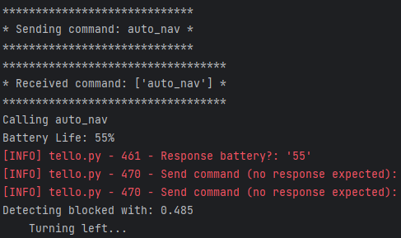
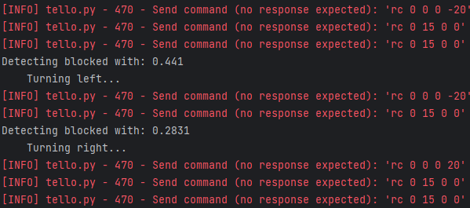
Taking Autonomous Flight (cont. again)
Once you’re ready, press the “Takeoff” button from the Command Button Window and then the “Auto_Nav” button to commence autonomous flight
Simultaneously, there will be printout information in the “Run Terminal” depicting (1) which button commands have been called, (2) commands being sent to the Tello (marked in red) and (3) when the drone has detected it has been BLOCKED
The p(blocked_or_unblocked) will be printed as well as which direction the drone will be turning
Once you’re done, press the “Land” button followed by “Kill” to stop the program
If at any point you want to stop the drone flight (i.e. drone is getting too close to the boxes), press the “Kill” button
Be aware that we only have a few minutes of flight time per drone battery, so you may have to continuously switch out batteries throughout this demonstration!

